Slide 1

Incremental Security Enforcement of Cyber Physical Systems
Team P1-07
Under the guidance of Dr. Sudeep K.S
Aaditya Kumar Muktavarapu -HU21CSEN0100580
Karthik Neriyanuri
-HU21CSEN0100607
Vijay Anirudh Vallabhu -HU21CSEN0100611
Lalit Narayanam -HU21CSEN0101246
School of Technology

Slide 2
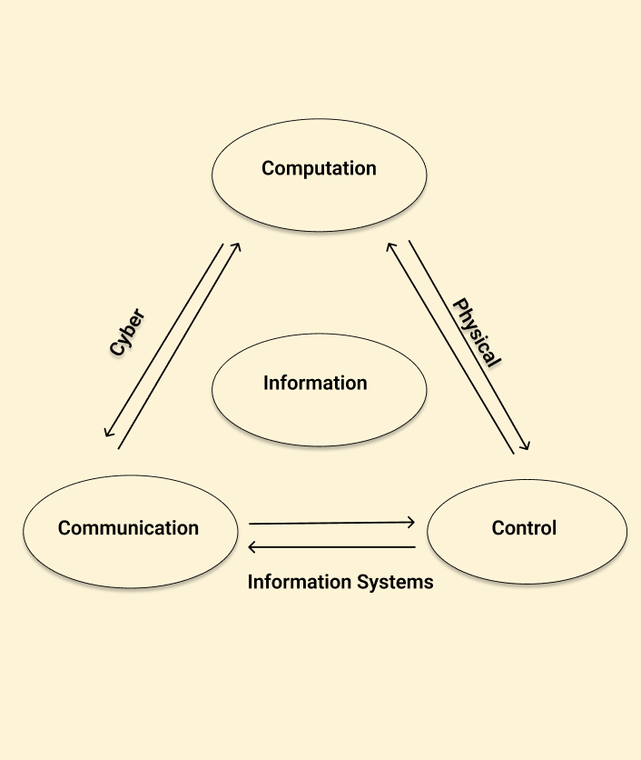

Introduction:
This capstone project will focus on developing an incremental security enforcement framework for Cyber-Physical Systems.
The project's goal is to create a framework that can incrementally add new security policies to CPS as new threats are identified. This will involve implementing runtime enforcement (RE) techniques that allow the system to integrate additional security measures without compromising the performance or integrity of existing ones.
School of Technology

Slide 3
Summary of Previous Reviews:
Runtime Enforcement Techniques
Monolithic Enforcement
Synchronous Approaches
Algorithm: Enforcing Security Incrementally
Serial Composition of Enforcers
School of Technology

Slide 4
Cyber Attacks
GPS Spoofing
Command Injection
Sensor Tampering
DoS attack
School of Technology

Slide 5
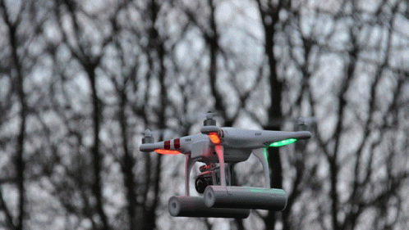

Slide 6
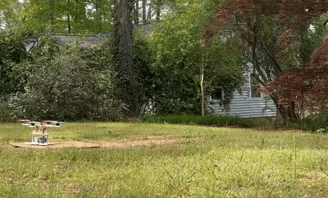

Slide 7
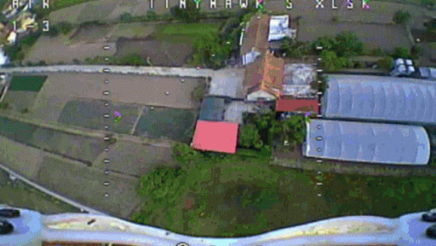

Slide 8
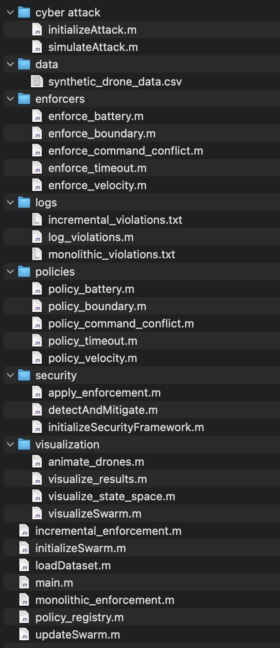
School of Technology

Slide 9
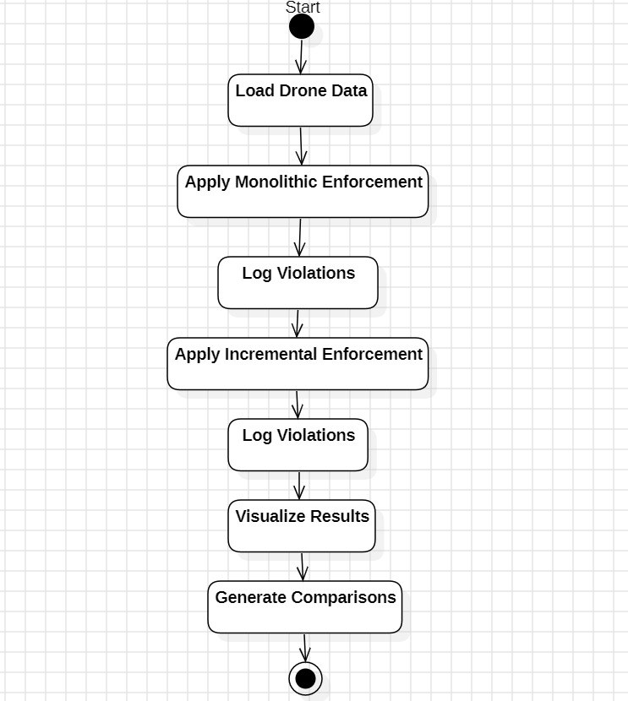
Implementation:
School of Technology

Slide 10
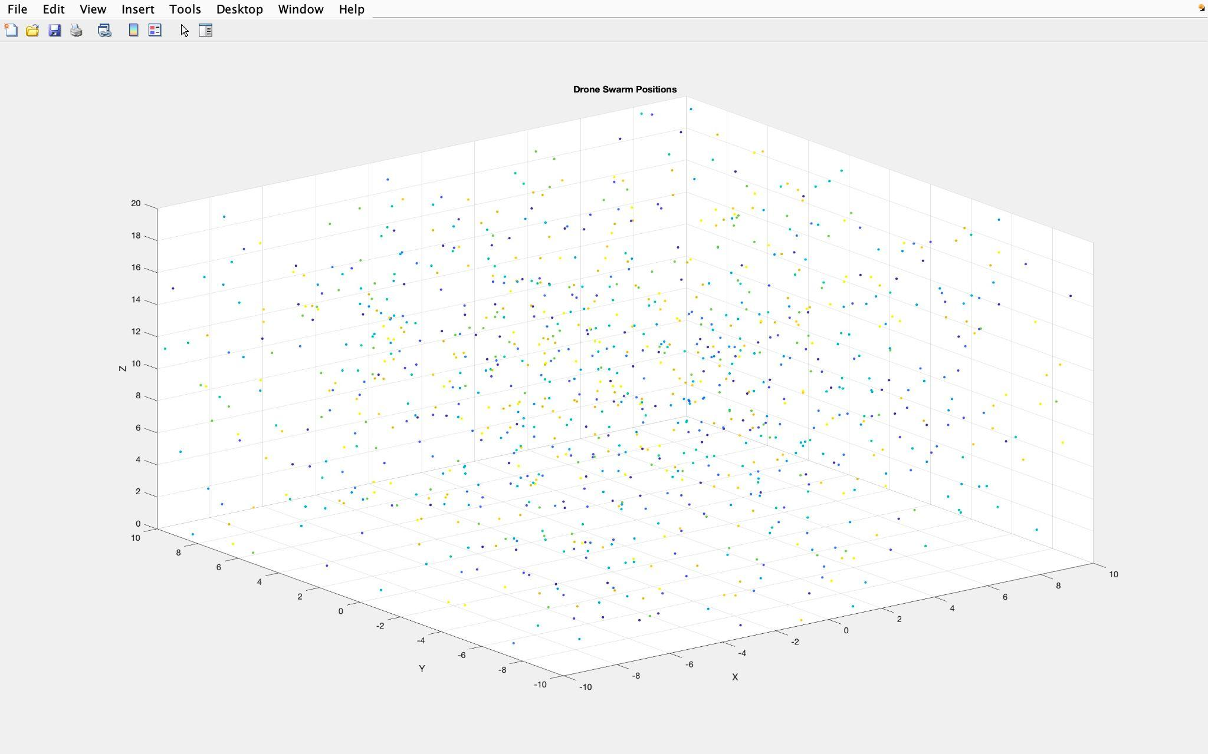
Graph:
School of Technology

Slide 11
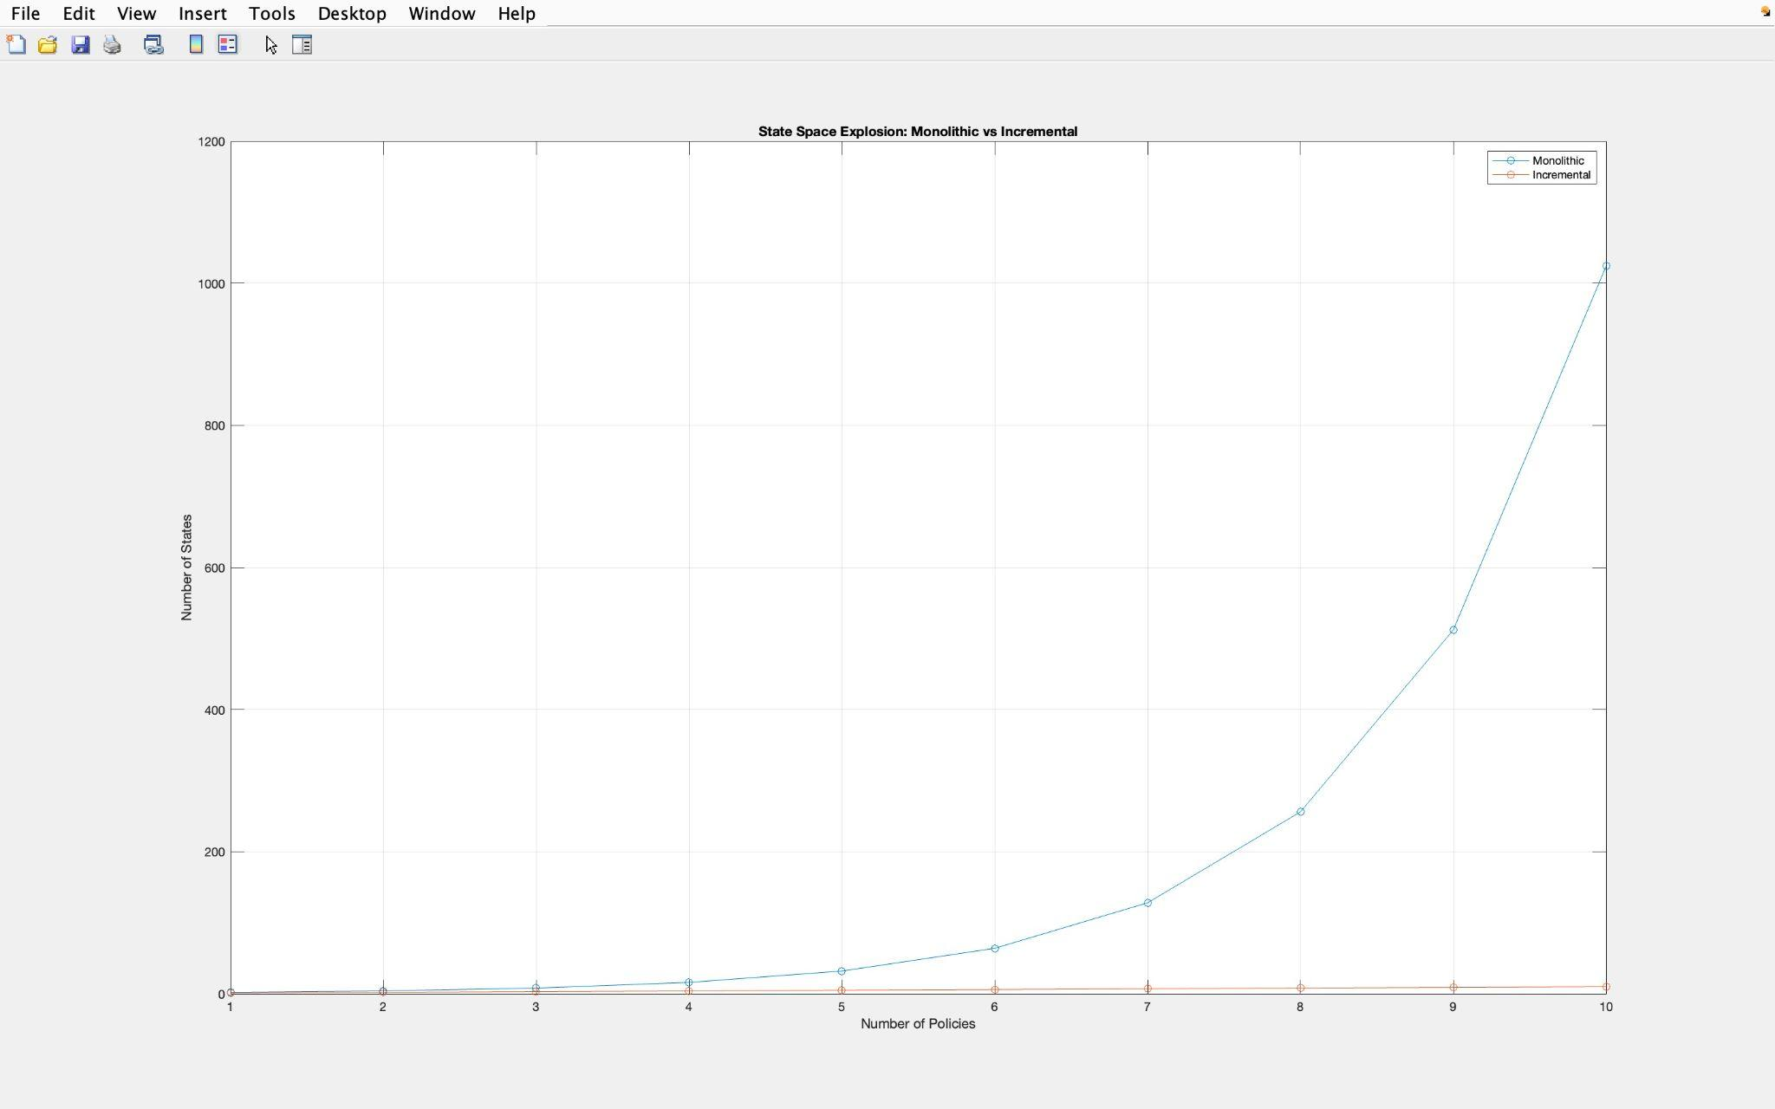
Graph:
School of Technology

Slide 12
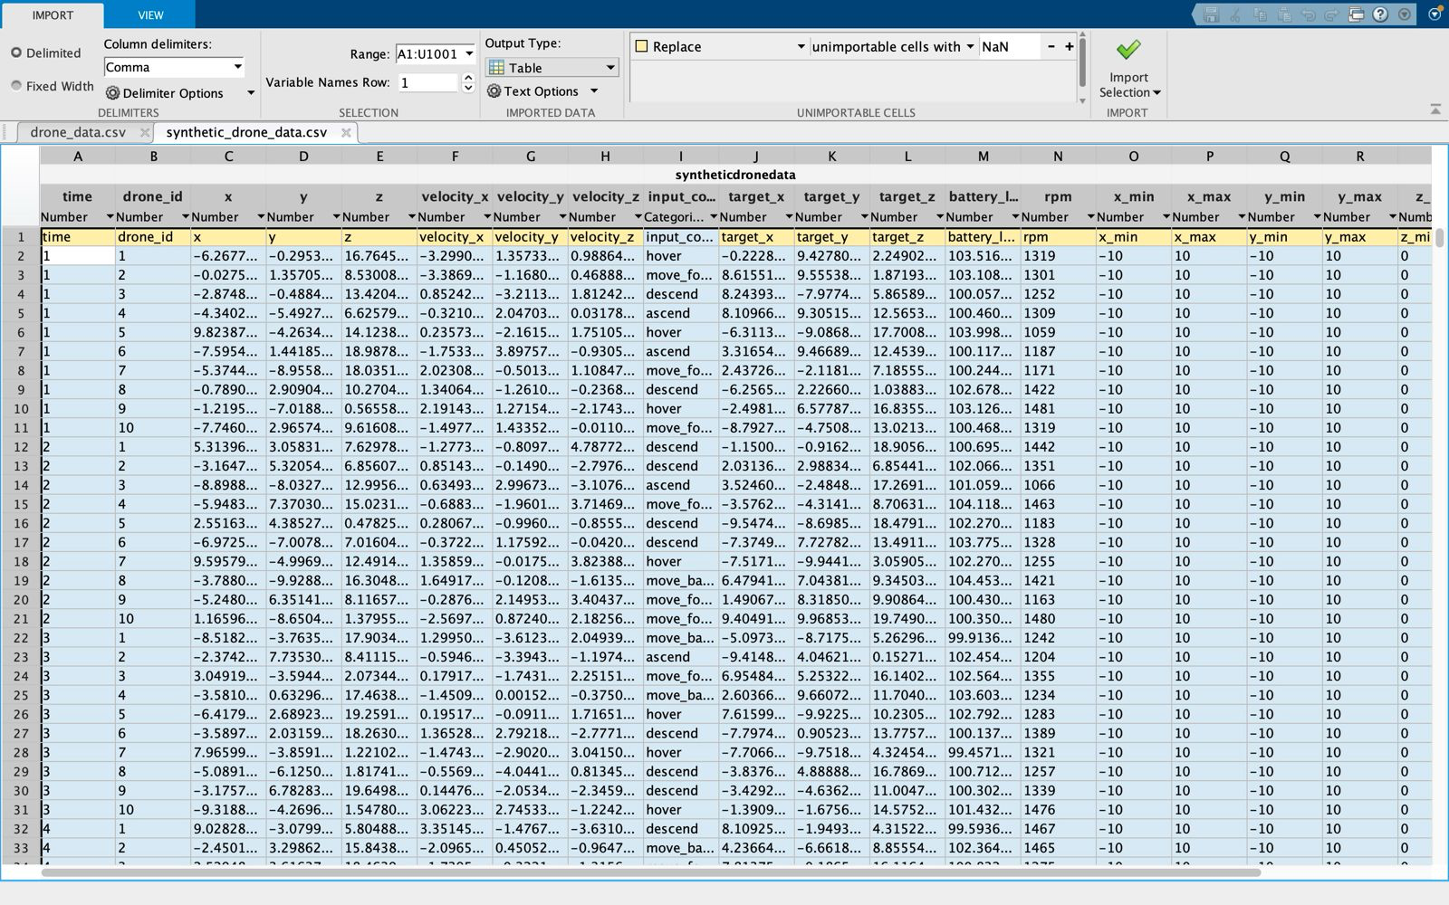
Dataset table :
School of Technology

Slide 13
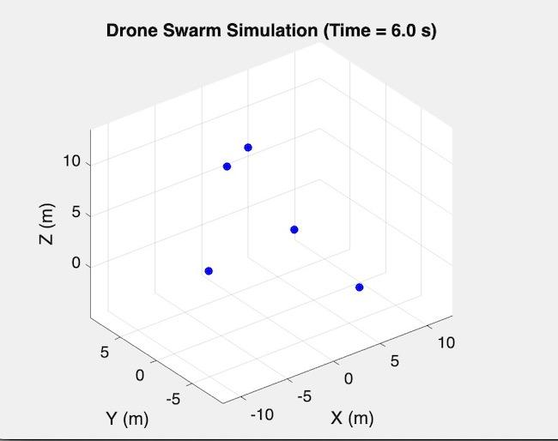
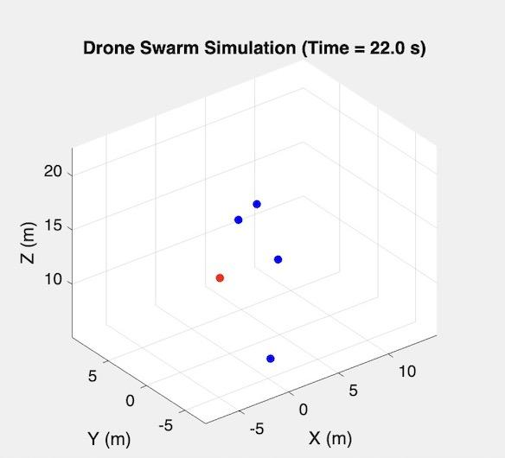
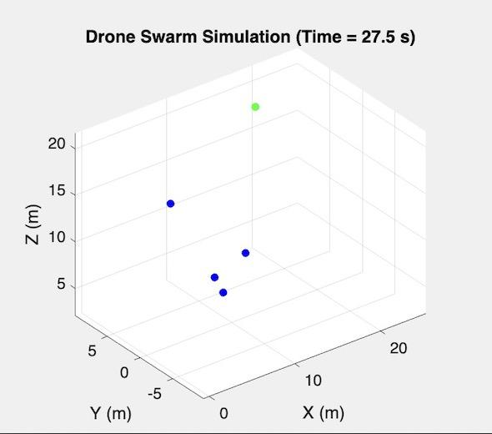
School of Technology

Slide 14
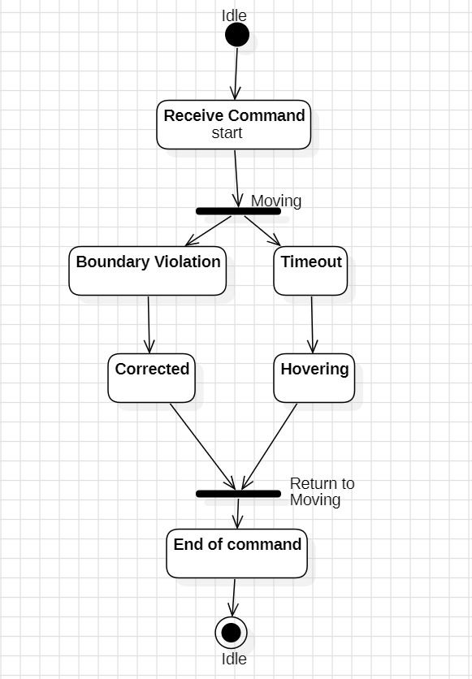
UML Diagrams:
School of Technology

Slide 15

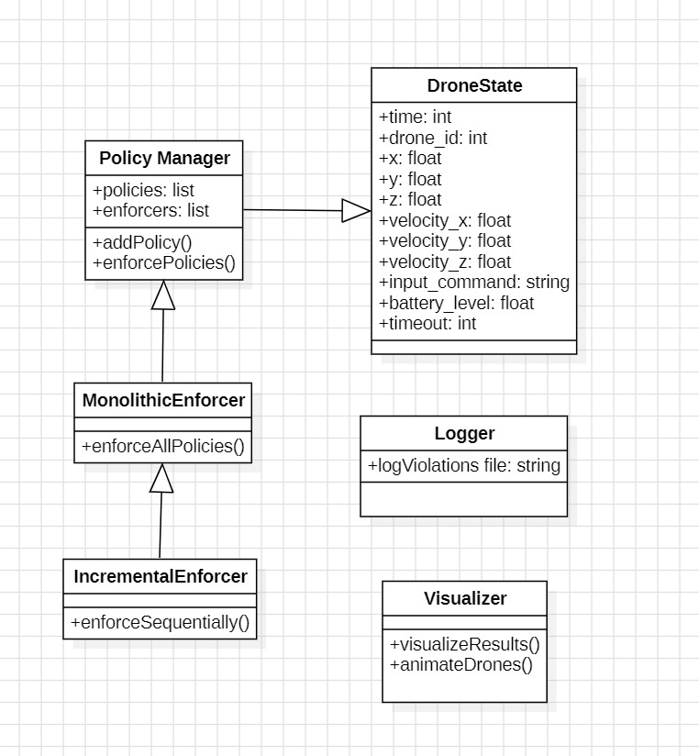
UML Diagrams:
School of Technology

Slide 16
Future Scope
Machine Learning for Adaptive Enforcement
Integration with Blockchain
Enhanced 3D Visualization
Scalability Testing on Large CPS Networks
Multi-Agent Collaboration & Attack Response
Hardware-in-the-Loop (HIL) Testing

Slide 17
Conclusion:
In summary, implemented part of the project was to visualize drone movements and a cyber attack in a 3D space and apply enforcement policies in a simulation environment. The implemented part covers the basics of drone simulation, 3D visualization, and policy enforcement, but there's room to enhance performance, usability, and real-time capability for more complex systems. Drone simulation is just one use case, there are other use cases where the approach can be implemented such as dev ops, cloud computing, cyber security, military etc.
School of Technology

Slide 18
References:
Incremental Security Enforcement for Cyber-Physical Systems by ABHINANDAN PANDA , ALEX BAIRD, SRINIVAS PINISETTY, AND PARTHA ROOP.
Scalable Security Enforcement for Cyber Physical Systems by ALEX BAIRD , ABHINANDAN PANDA , HAMMOND PEARCE , SRINIVAS PINISETTY , AND PARTHA ROOP.
Monitoring and Defense of Industrial Cyber-Physical Systems Under Typical Attacks: by Yuchen Jiang , Shimeng Wu , Renjie Ma , Ming Liu, Hao Luo, and Okyay Kaynak.
School of Technology

Slide 19
Thank You
School of Technology

